Slide 1
K-nearest neighbors (KNN)
K-nearest neighbors (KNN) is a type of supervised learning algorithm used for both regression and classification.
KNN tries to predict the correct class for the test data by calculating the distance between the test data and all the training points. Then select the K number of points which is closet to the test data.
The KNN algorithm calculates the probability of the test data belonging to the classes of ‘K’ training data and class holds the highest probability will be selected.
In the case of regression, the value is the mean of the ‘K’ selected training points.

Slide 2
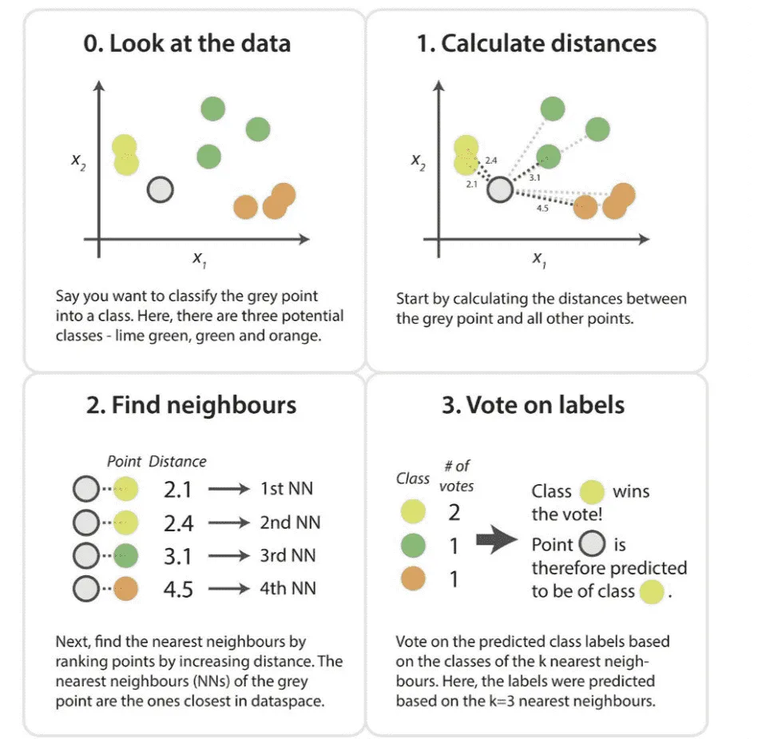
K-nearest neighbors (KNN)

Slide 3
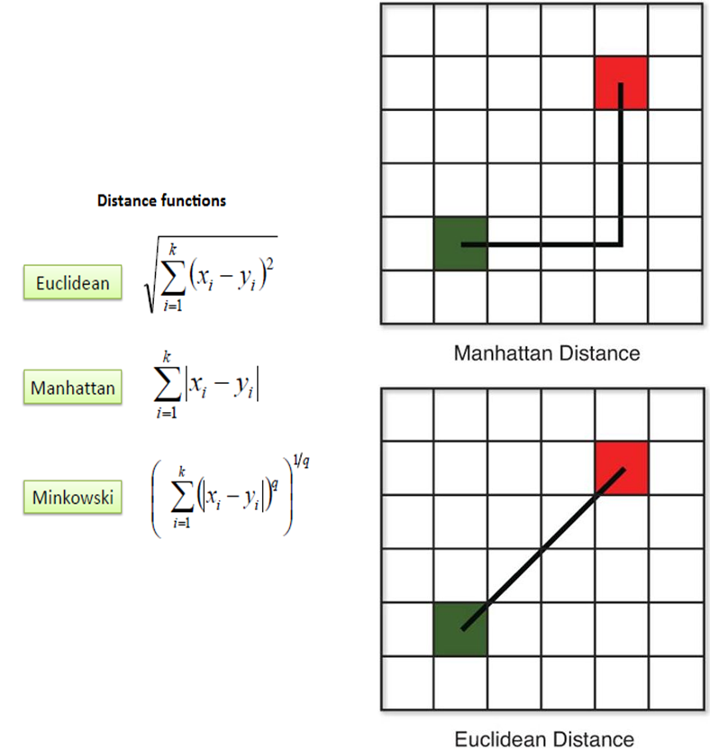
KNN: distance metrics
There are several distance measures that you can choose from, to determine which data points are closest to a given query point
Euclidean distance (p=2): This is the most used distance measure, and it is limited to real-valued vectors. Using the below formula, it measures a straight line between the query point and the other point being measured.
Manhattan distance (p=1): This is also another popular distance metric, which measures the absolute value between two points. It is also referred to as taxicab distance or city block distance as it is commonly visualized with a grid, illustrating how one might navigate from one address to another via city streets.
Minkowski distance: This distance measure is the generalized form of Euclidean and Manhattan distance metrics. The parameter, p, in the formula below, allows for the creation of other distance metrics. Euclidean distance is represented by this formula when p is equal to two, and Manhattan distance is denoted with p equal to one.
Note: q is used instead of p in equations

Slide 4
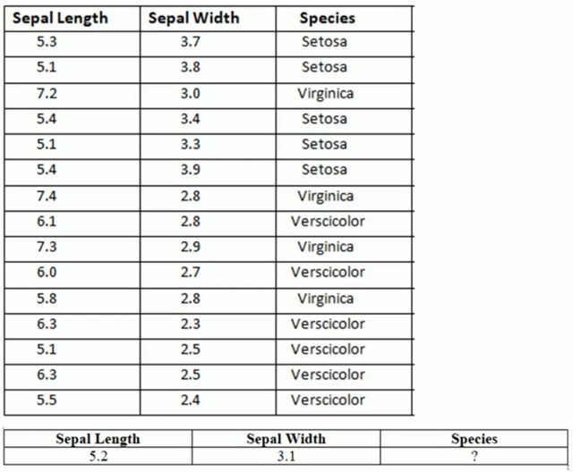
KNN classifier example

Slide 5
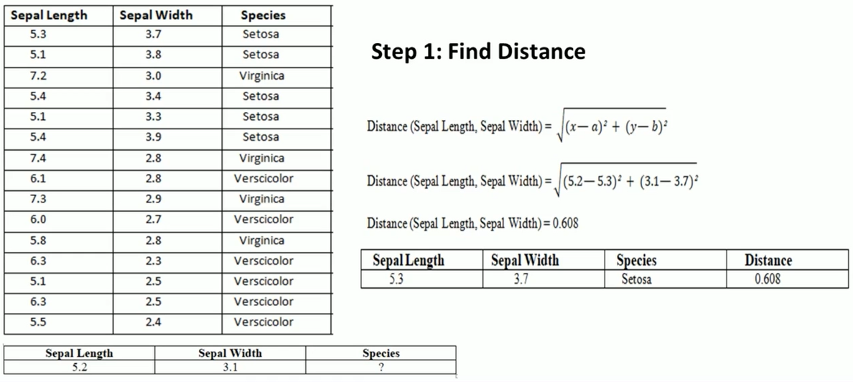
KNN classifier example

Slide 6
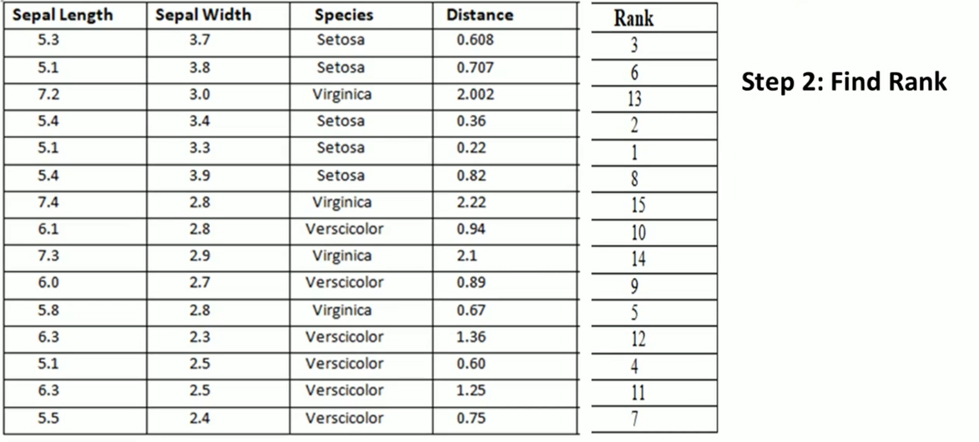
KNN classifier example

Slide 7
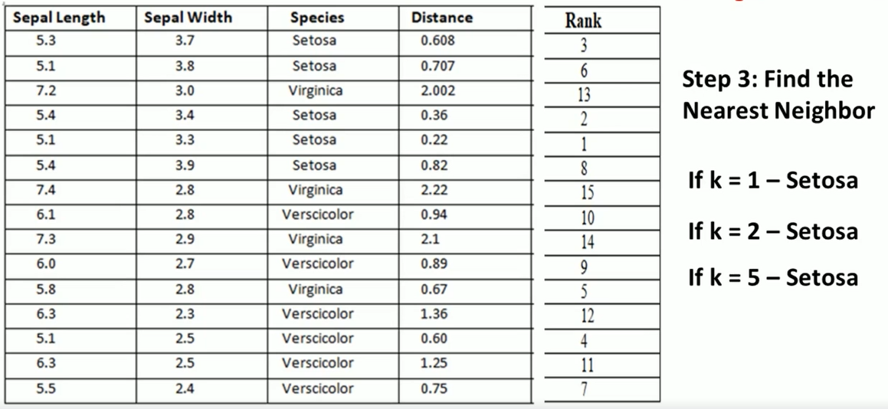
KNN classifier example

Slide 8
Approximation of discrete-valued target function

Slide 9
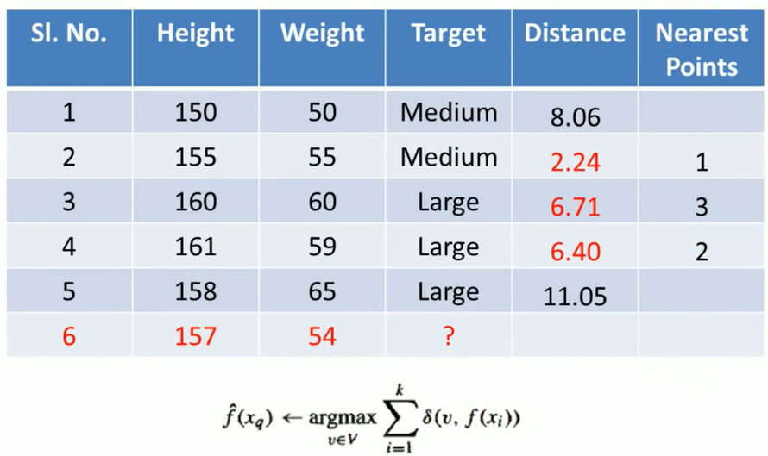
Approximation of discrete-valued target function

Slide 10
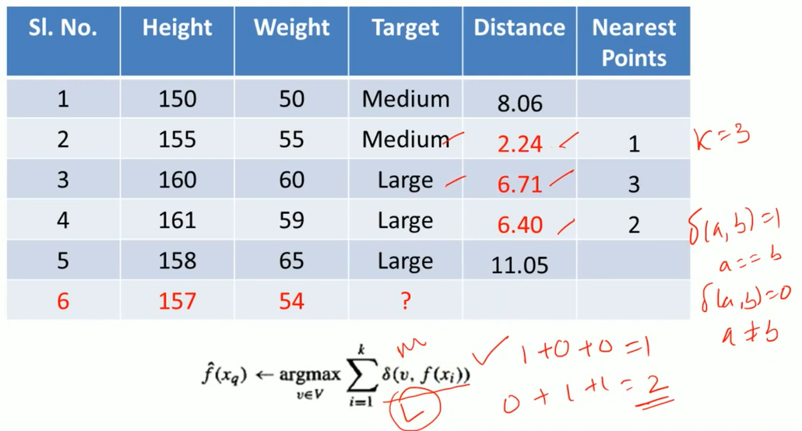
Approximation of discrete-valued target function

Slide 11
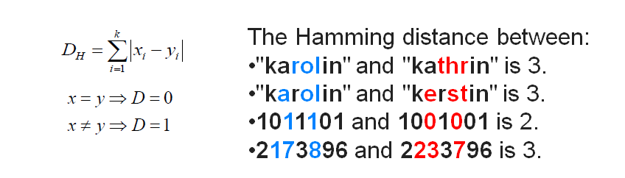
Hamming Distance for Nominal and binary attributes

Slide 12
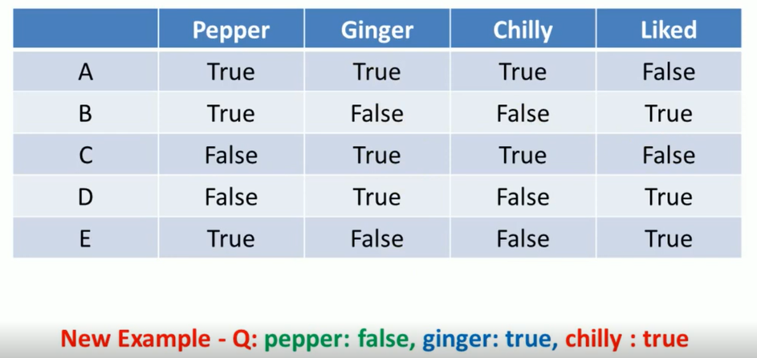
Burger liking example using hamming distance

Slide 13
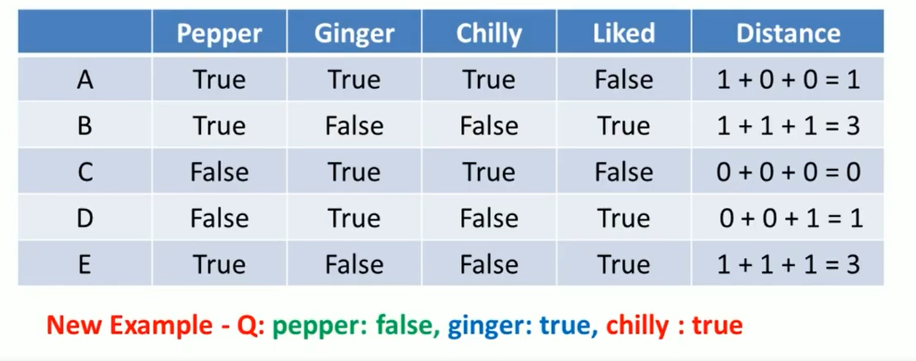
Burger liking example using hamming distance

Slide 14
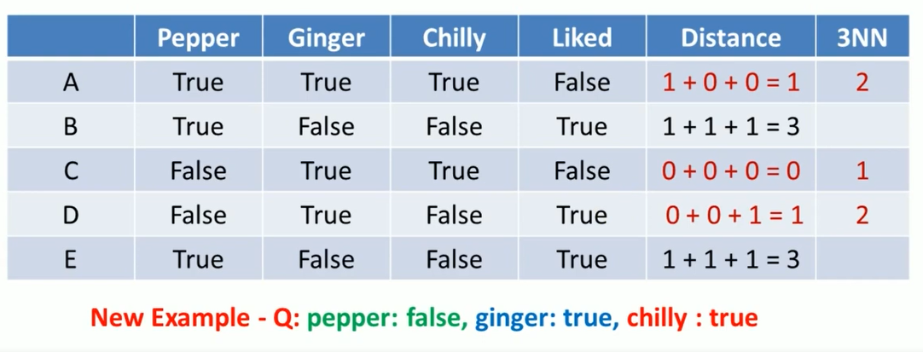
Burger liking example using hamming distance

Slide 15
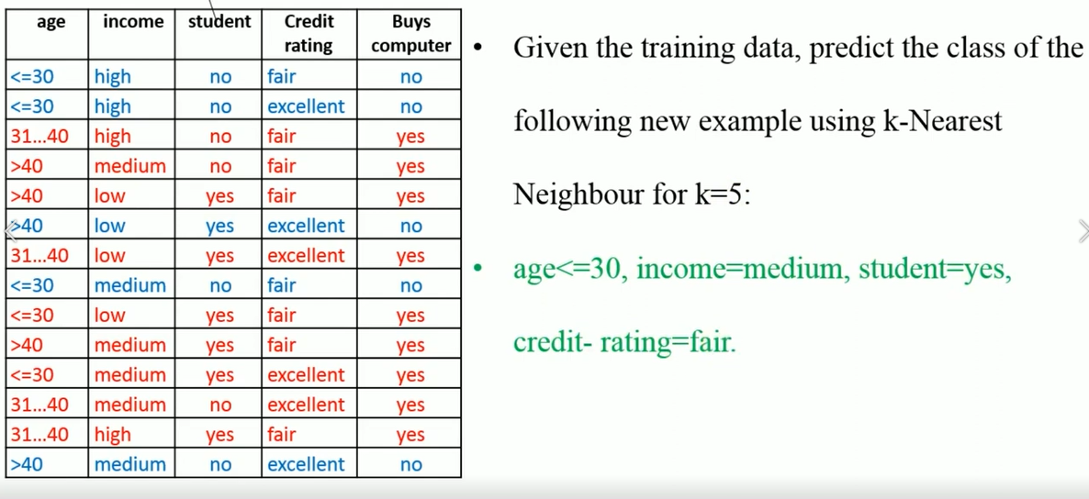
Weighted similarity measure

Slide 16
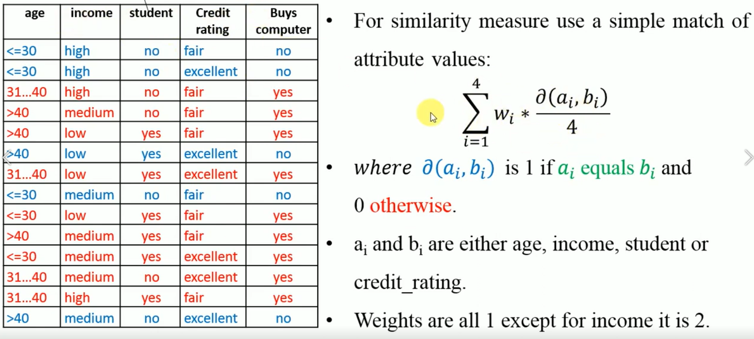
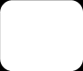
Weighted similarity measure

Slide 17
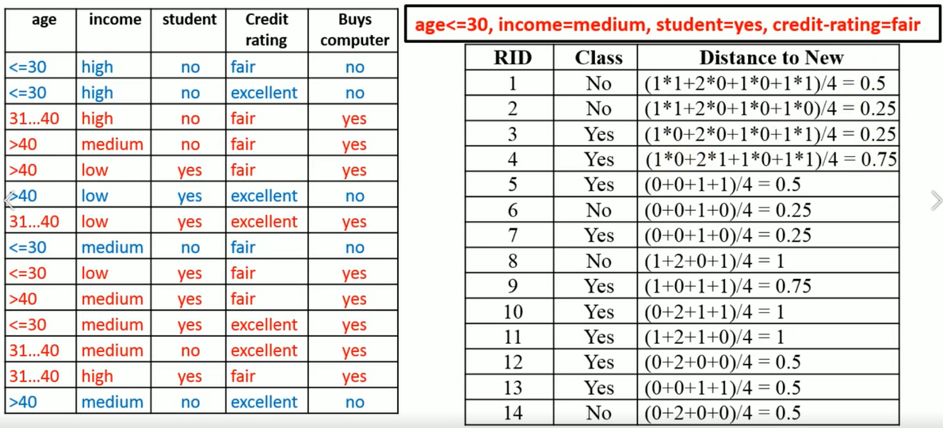
Weighted similarity measure
Similarity

Slide 18
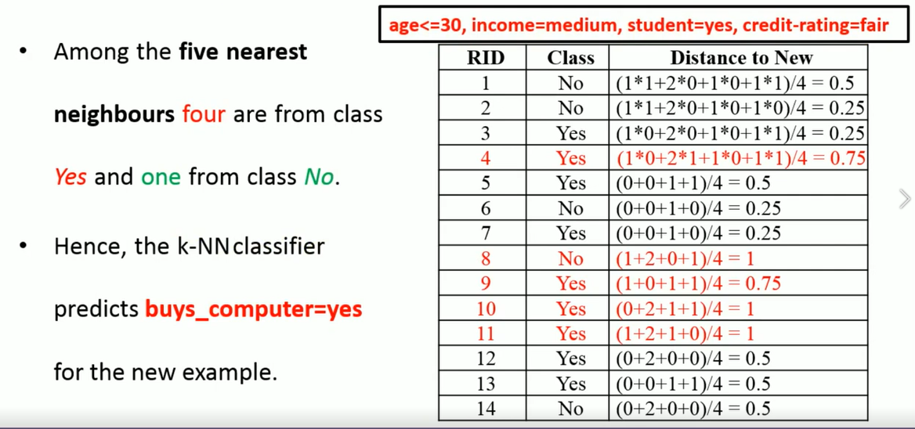

Weighted similarity measure

Slide 19
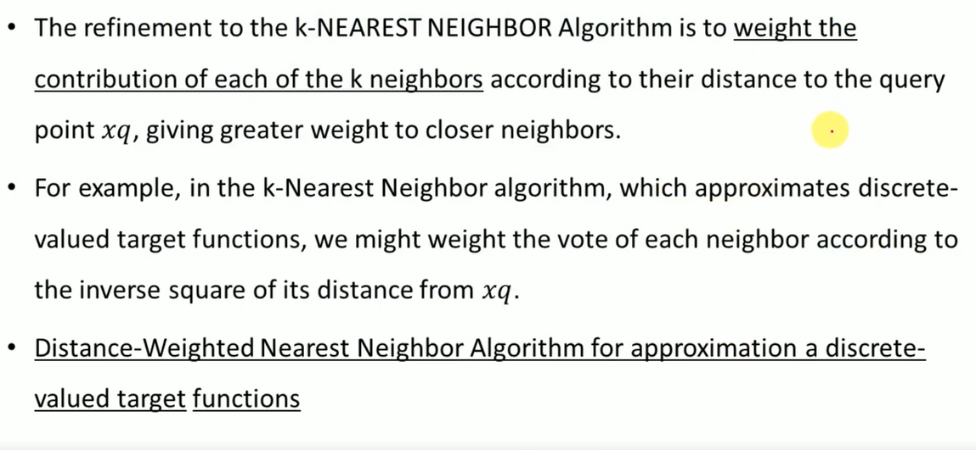
Distance-weighted Nearest Neighbor Algorithm

Slide 20
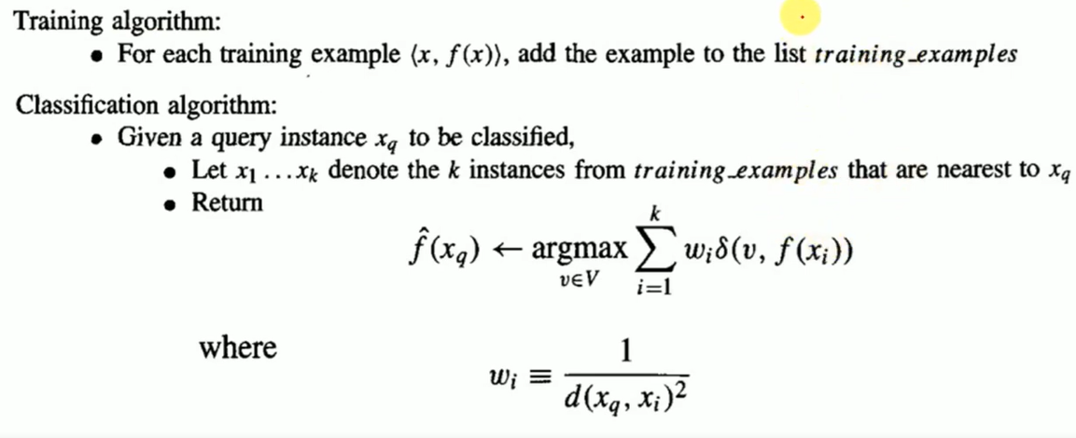
Distance-weighted Nearest Neighbor Algorithm

Slide 21
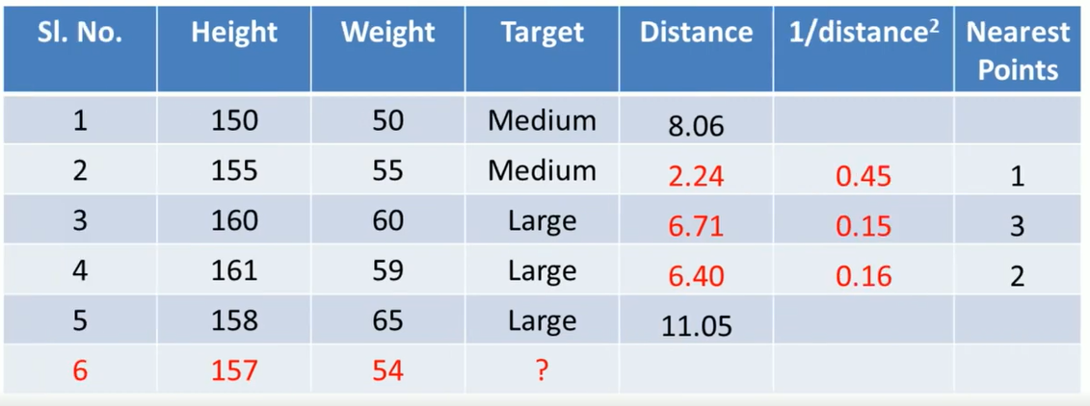
Distance-weighted Nearest Neighbor Algorithm

Slide 22
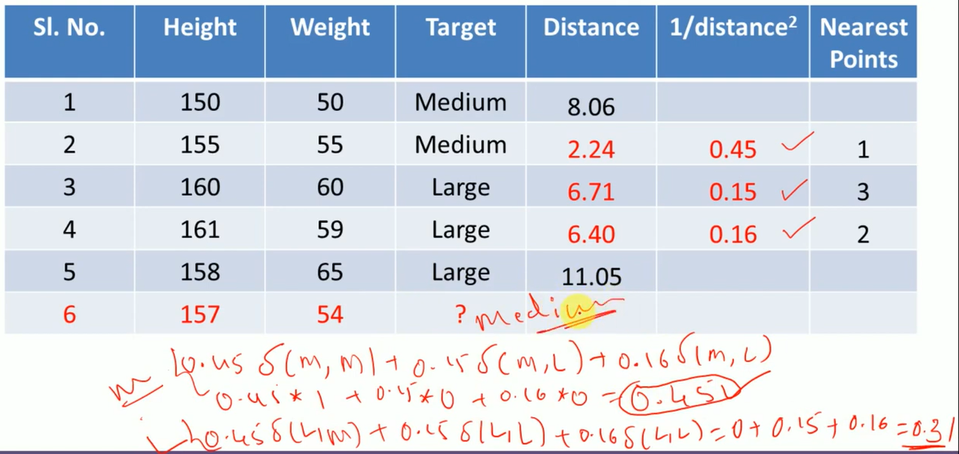
Distance-weighted Nearest Neighbor Algorithm

Slide 23
Approximation of real-valued target function

Slide 24
Distance-weighted Nearest Neighbor Algorithm

Slide 25
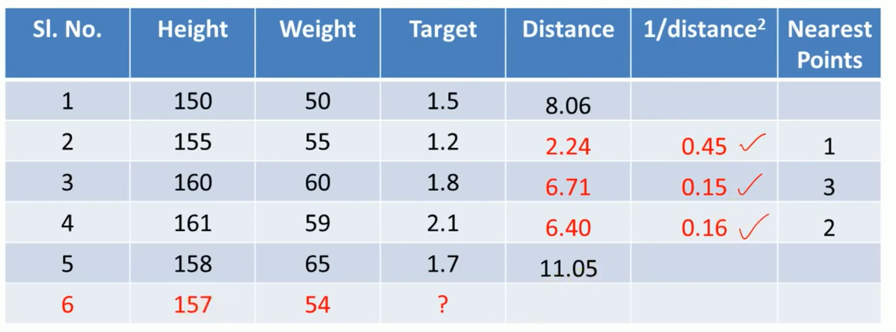
Distance-weighted Nearest Neighbor Algorithm

Slide 26
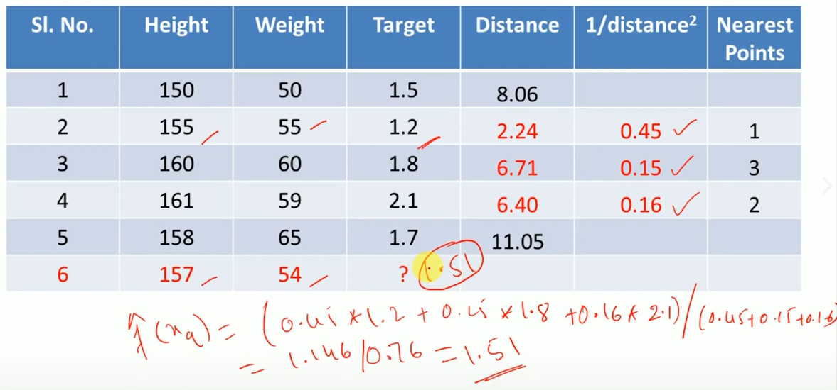
Distance-weighted Nearest Neighbor Algorithm

